Slide 1



Front End Engineering
Project
Report
Parth Awasthi
2110991003

Slide 2

Table of content
Introduction
1
Why React ?
2
Objectives of To - Do List
3
Testing and Quality Assurance
4
Project Flow
5
Conclusion
6
References
8
Thank You
10

Slide 3

INTRODUCTION
Our web application offers a user-friendly to-do list that simplifies task management in today's fast-paced world.
Designed for efficiency and productivity, our software provides a clear and intuitive interface to help individuals and teams prioritize tasks and regain control of their busy lives.
With reliable features and smooth usability, our configuration software is the solution for a more organized and efficient way to manage daily tasks.

Slide 4

RICH USER INTERFACES
ability to create dynamic and interactive user interfaces
EFFICIENT DEVELOPMENT
Why React ?
React's virtual DOM and one-way data flow make it efficient
SCALABILITY
React is highly scalable, making it suitable for both small and large projects

Slide 5



Objectives
TO - DO LIST
EFFICIENT TASK MANAGEMENT
COMPREHENSIVE TESTING
CONTINUOUS SUPPORT AND MAINTENANCE
enables users to efficiently manage their tasks
Conduct thorough testing, including unit testing
ongoing maintenance and support to address issues

Slide 6

TESTING AND QUALITY ASSURANCE
Spain
MEXICO
Rigorous testing was performed throughout the development process, including unit testing, integration testing, and user acceptance testing. Bugs were identified and fixed quickly to ensure the application and its reliability and durability.
Brazil

Slide 7
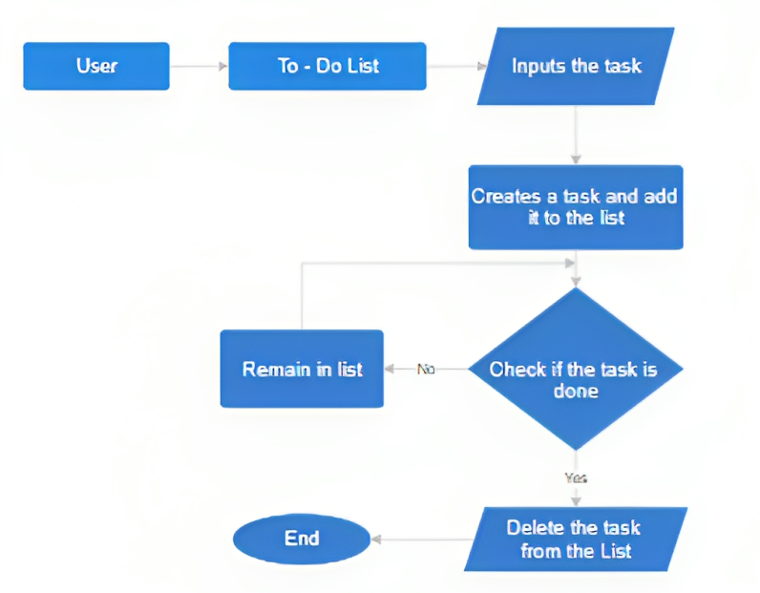

Project Flow
THE FLOW OF THE PROJECT IS IN THE FOLLOWING WAY :
Screenshots of the project

Slide 8
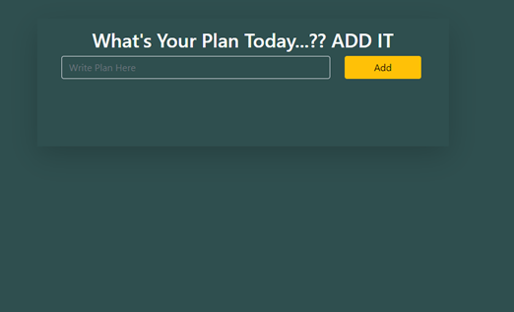

REACT APP START
This is the first page that opens or is vsisible when the user starts the web application.

Slide 9
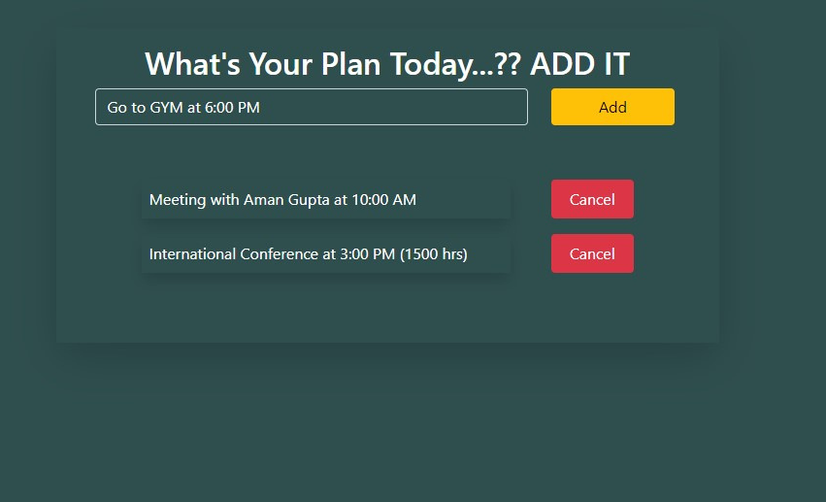
ADDING A TASK INTO LIST
When a user wants to add a task in the he/she has to write the description in the input box and click on add button to add the task in the list

Slide 10
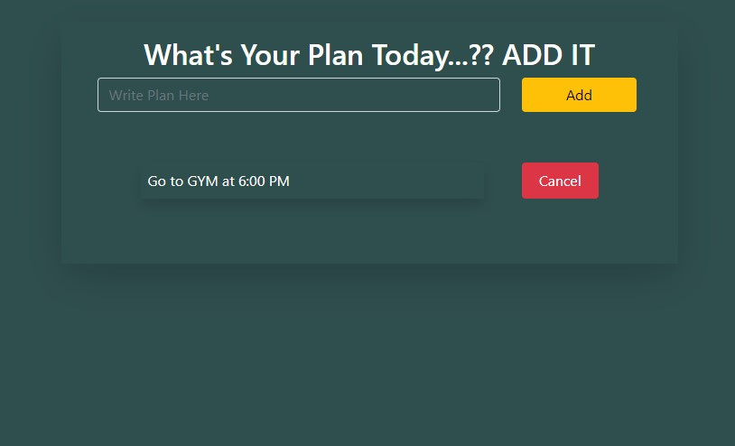
DELETING THE TASK FROM LIST
When a user feels that the task that he/she has added is complete he/she can click on the Cancel button to delete the task from the list.

Slide 11

CONCLUSION
In short, it can be stated that the To-Do List web application developed with React is an effective solution for users to manage their tasks. Thanks to its user-friendly interface, strong functionality and responsive design, it improves productivity and organization. This project successfully accomplishes its goals and is a valuable task management tool. Ongoing maintenance and user feedback ensure its continued effectiveness and relevance, helping people stay organized and manage their responsibilities.

Slide 12


https://reactjs.org/
References :
https://redux.js.org
https://developer.mozilla.org/en-US/docs/Web/CSS
https://github.com
https://www.google.com/

Slide 13

Thank You

